Slide 1


Enterprise Applications and Business Process Integration
Chapter 10

Slide 2
Objectives
How do enterprise systems provide value for businesses? How does enterprise software work?
How do supply chain management systems provide value for businesses? What does supply chain management software do?

Slide 3
Objectives
How do customer relationship management systems provide value for businesses? What does customer relationship management software do?
How can enterprise applications be used in platforms for new cross-functional services?
What are the challenges of implementing and using the various enterprise applications?

Slide 4
Management Challenges
Thinking beyond the walls of corporation
Obtaining value from enterprise applications

Slide 5
Enterprise Systems
How Enterprise Systems Work
Enterprise Software: Set of integrated software modules for finance and accounting, human resources, manufacturing and production, and sales and marketing that allows data to be used by multiple functions and business processes

Slide 6
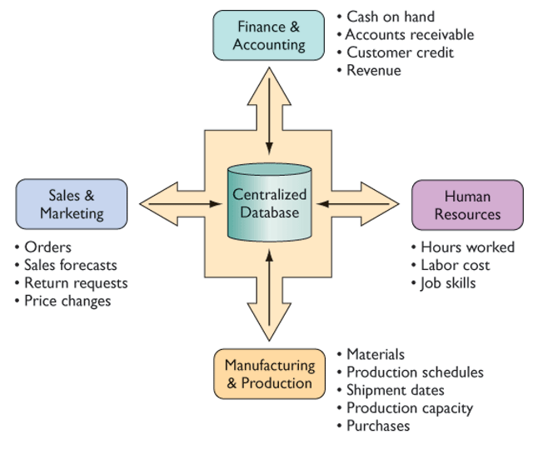
Enterprise Systems
Enterprise system architecture
Figure 10-1

Slide 7
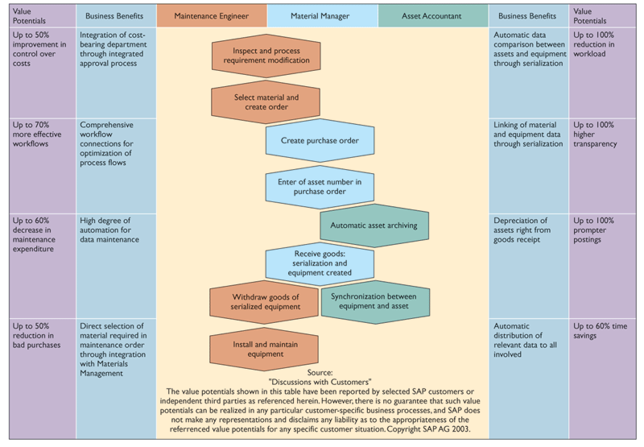
Enterprise Systems
Process map for procuring new equipment
Figure 10-2

Slide 8
Enterprise Systems
How Enterprise Systems Work
Best Practices: The most successful solutions or problem-solving methods for consistently and effectively achieving a business objective

Slide 9
Enterprise Systems
Benefits and Challenges of Enterprise Systems
Benefits of Enterprise Systems
Firm Structure and Organization: One Organization
Management: Firmwide Knowledge-Based Management Processes

Slide 10
Enterprise Systems
Benefits and Challenges of Enterprise Systems
Benefits of Enterprise Systems
Technology: Unified Platform
Business: More Efficient Operations and Customer-Driven Business Processes

Slide 11
Enterprise Systems
Benefits and Challenges of Enterprise Systems
Enterprise System Challenges
Daunting Implementation
High Up-Front Costs and Future Benefits
Inflexibility
Realizing Strategic Value

Slide 12
Supply Chain Management Systems
Supply Chain Processes
Plan: Balances aggregate demand and supply to develop a course of action
Source: Processes that procure goods and services needed to create a specific product or service
Make: Processes that transform a product into a finished state to meet planned or actual demand

Slide 13
Supply Chain Management Systems
Supply Chain Processes
Deliver: Processes that provide finished goods and services to meet actual or planned demand
Return: Processes associated with returning products or receiving returned products

Slide 14
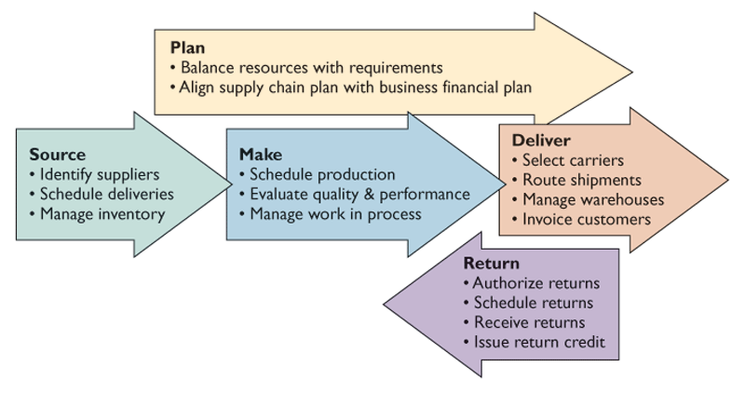
Supply Chain Management Systems
Key supply chain management processes
Figure 10-3

Slide 15
Supply Chain Management Systems
Supply Chain Processes
Logistics: Planning and control of all factors that will have an impact on transporting a product or service

Slide 16
Supply Chain Management Systems
Information and Supply Chain Management
Just-in-Time: Scheduling system for minimizing inventory by having components arrive exactly at the time they are needed and finished goods shipped as soon as they leave the assembly line
Bullwhip Effect: Distortion of information about demand for a product as it passes from one entity to the next across the supply chain

Slide 17
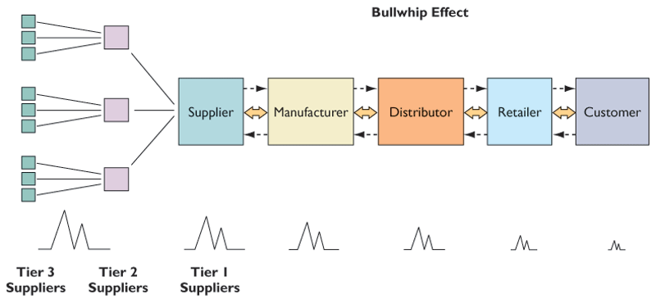
Supply Chain Management Systems
The bullwhip effect
Figure 10-4

Slide 18
Supply Chain Management Systems
Supply Chain Management Applications
Supply Chain Planning Systems: Enable a firm to generate demand forecasts for a product and to develop sourcing and manufacturing plans
Demand Planning: Determining how much product a business needs to make to satisfy all its customers’ demands

Slide 19
Supply Chain Management Systems
Supply Chain Management Applications
Supply Chain Execution Systems: Manage the flow of products through distribution centers to ensure that they are delivered to the right locations in the most efficient manner

Slide 20
Supply Chain Management Systems
Supply Chain Management Applications
Supply Chain Strategy
Functional Products: Typical offerings that have predictable demand, high lifecycles, and often low profit margins
Innovative Products: Products with more unpredictable demand and short product lifecycles, but higher profit margins

Slide 21
Supply Chain Management Systems
Supply Chain Management Applications
Supply Chain Performance Measurement
Metric: Standard measurement of performance

Slide 22
Supply Chain Management Systems
Supply Chain Management Applications
Supply Chain Management and the Internet
Intranet: Improve coordination among internal supply chain processes
Extranet: Coordinates supply chain processes shared with an organization’s business partners

Slide 23
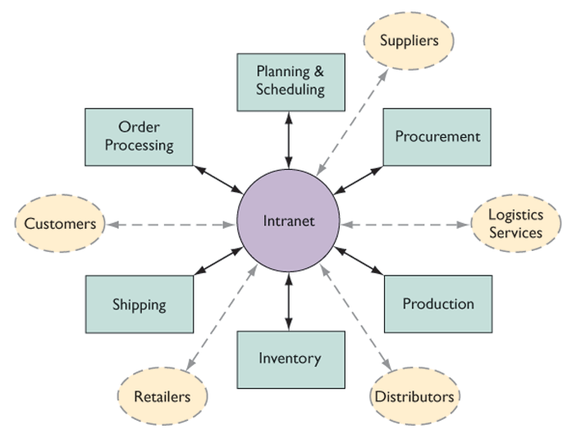
Supply Chain Management Systems
Intranets and extranets for supply chain management
Figure 10-5

Slide 24
Supply Chain Management Systems
Window on Organizations
Collaborative Logistics Pays Off for
Land O’Lakes
What are the advantages and drawbacks of collaborative logistics?
How do firms obtain value from using load-sharing systems?
Why is Web technology so helpful?

Slide 25
Supply Chain Management Systems
Supply Chain Management Applications
Global Supply Chain Issues
Typically span greater geographic distances and time differences than domestic supply chains
Strategy may need to reflect foreign government regulations and cultural differences

Slide 26
Supply Chain Management Systems
Supply Chain Management Applications
Demand-Driven Supply Chains: From Push to Pull Manufacturing and Efficient Customer Response
Push-Based Model: Supply chain driven by production master schedules based on forecasts of demand, and products are “pushed” to customers
Pull-Based Model: Supply chain driven by actual customer orders so that members only produce what is ordered

Slide 27
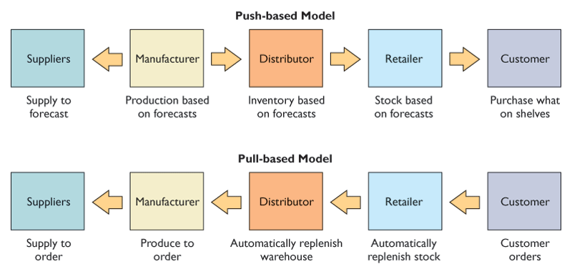
Supply Chain Management Systems
Push versus pull-based supply chain models
Figure 10-6

Slide 28
Supply Chain Management Systems
Benefits and Challenges of Supply Chain Management Systems
Supply Chain Management Benefits
Improved customer service and responsiveness
Cost reduction
Cash utilization

Slide 29
Supply Chain Management Systems
Benefits and Challenges of Supply Chain Management Systems
Supply Chain Management Challenges
If the software is implemented atop flawed processes, it can actually make matters worse
Businesses must identify exactly how processes must change to take advantage of the software

Slide 30
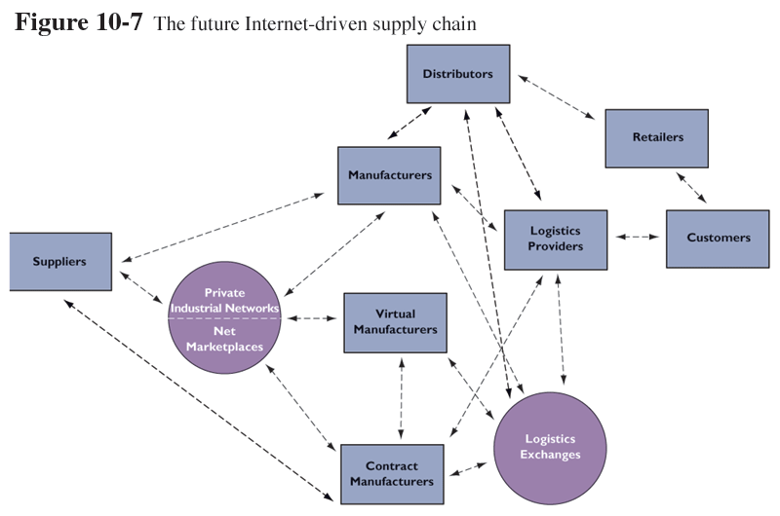
Supply Chain Management Systems
The future Internet-driven supply chain
Figure 10-7

Slide 31
Customer Relationship Management Systems
Customer Relationship Management and Partner Relationship Management
Customer Relationship Management (CRM): Helps firms maximize the benefits of their customer assets
Partner Relationship Management (PRM): Automation of the firm’s relationships with its selling partners using customer data and analytical tools

Slide 32
Customer Relationship Management Systems
Customer Relationship Management Applications
Touch Point: Method of firm interaction with a customer, such as telephone, e-mail, customer service desk, conventional mail, or point-of purchase

Slide 33
Customer Relationship Management Systems
Customer Relationship Management Applications
Customer Data May Come From:
Responses to direct mail campaigns
Web site interactions
Bricks-and-mortar stores or branches
Call centers
Sales force staff

Slide 34
Customer Relationship Management Systems
Customer Relationship Management Applications
Customer Data May Come From:
Advertising and marketing activities
Sales and purchase data
Account data
Service and support records
Legacy data

Slide 35
Customer Relationship Management Systems
Customer Relationship Management Applications
Customer Data May Be Acquired
From External Sources
Customer lists from direct marketing campaigns
Demographic data
Psychographic data

Slide 36
Customer Relationship Management Systems
Customer Relationship Management Applications
Customer Relationship Management (CRM) Application Software
Packages contain modules for partner relationship management (PRM) and employee relationship management (ERM)

Slide 37
Customer Relationship Management Systems
Customer Relationship Management Applications
Cross-Selling: Marketing complimentary products to customers
Up-Selling: Marketing higher-value products or services to new or existing customers
Bundling: Cross-selling in which a combination of products is sold as a bundle at a lower price

Slide 38
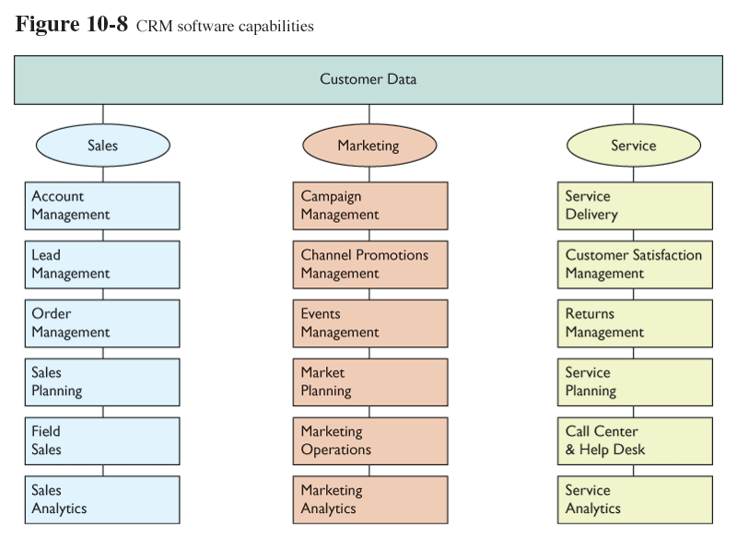
Customer Relationship Management Systems
CRM software capabilities
Figure 10-8

Slide 39
Customer Relationship Management Systems
Operational and Analytical CRM
Churn Rate: Measurement of number of customers who stop using or purchasing products or services from a company
Operational CRM: Customer-facing applications, such as sales force automation, call center and customer service support, and marketing automation

Slide 40
Customer Relationship Management Systems
Operational and Analytical CRM
Analytical CRM: Application dealing with the analysis of customer data to provide information for improving business performance

Slide 41
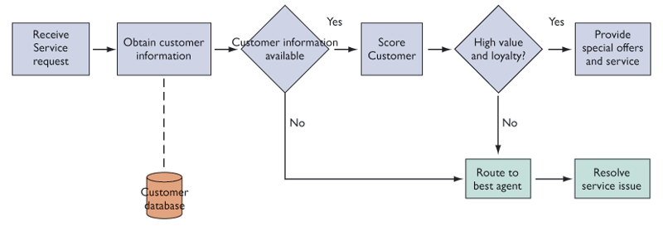
Customer Relationship Management Systems
Customer loyalty management process map
Figure 10-9

Slide 42
Customer Relationship Management Systems
Operational and Analytical CRM
Market Segmentation: Dividing a heterogeneous market into smaller, more homogeneous subgroups where marketing efforts can be more specifically targeted and effective

Slide 43
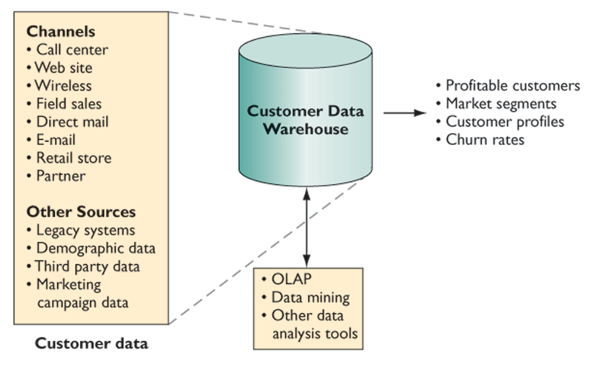
Customer Relationship Management Systems
Analytical CRM data warehouse
Figure 10-10

Slide 44
Customer Relationship Management Systems
Operational and Analytical CRM
Firms could analyze customer data to focus on:
Profitability levels
Numbers, types, or usage of multiple products
Product pricing
Total revenue anticipated
Likelihood of acquiring a new product

Slide 45
Customer Relationship Management Systems
Benefits and Challenges of Customer Relationship Management Systems
Benefits of Customer Relationship
Management Systems
Increased customer satisfaction
Reduced marketing costs and more effective marketing
Lower costs for customer acquisition and retention

Slide 46
Customer Relationship Management Systems
Benefits and Challenges of Customer Relationship Management Systems
Customer Relationship Management Systems Challenges
Costs run higher for organizations with global operations
Failure rate for CRM systems can run as high as 55% to 75% because of cost overruns, integration challenges, and poor user acceptance of the new system

Slide 47
Customer Relationship Management Systems
Benefits and Challenges of Customer Relationship Management Systems
Metrics for Customer Relationship Management
Cost per lead
Cost per sale
Number of repeat customers
Reduction of churn

Slide 48
Customer Relationship Management Systems
Benefits and Challenges of Customer Relationship Management Systems
Metrics for Customer Relationship Management
Customer satisfaction
Number or percentage of problems/complaints
Lead generation rate
Lead conversion rate
Sales closing rate

Slide 49
Customer Relationship Management Systems
Benefits and Challenges of Customer Relationship Management Systems
Customer Lifetime Value (CLTV): Difference between revenues produced by a specific customer and the expenses for acquiring and servicing that customer minus the cost of promotional marketing over the lifetime of the customer relationship expressed in today’s dollars

Slide 50
Customer Relationship Management Systems
Window on Management
Canadian Firms Show How to Succeed with Customer Relationship Management
What management and organizational factors explain these companies’ success with customer relationship management?
Why is it that all companies cannot duplicate their success?

Slide 51
Enterprise Integration Trends
Extending Enterprise Software
Major software vendors have developed Web-enabled software for:
Customer relationship management
Supply chain management
Decision support
Enterprise portals

Slide 52
Enterprise Integration Trends
Service Platforms and Business Process Management
Service Platform: Integration of multiple applications from multiple business functions, units, or partners to deliver a seamless experience for the customer, employee, manager, or business partner

Slide 53
Enterprise Integration Trends
Service Platforms and Business Process Management
Business Process Management: Methodology for revising the organization’s business processes to use business processes as fundamental building blocks of corporate information systems

Slide 54
Enterprise Integration Trends
Enterprise Portals
Enterprise Portal: Web interface providing a single entry point for accessing organizational information and services

Slide 55
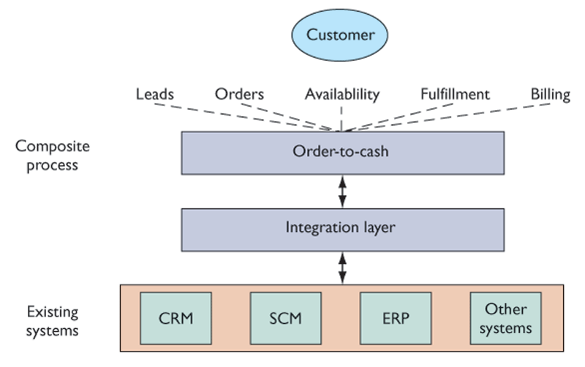
Enterprise Integration Trends
Order-to-cash service
Figure 10-11

Slide 56
Chapter 10 Case Study
Enterprise Integration: The Pepsi Challenge
Analyze PepsiCo using the value chain and competitive forces models. How did the company respond to its competitive environment?
Were the “power of one” principle and preselling good ideas for PepsiCo? Why or why not?

Slide 57
Chapter 10 Case Study
Enterprise Integration: The Pepsi Challenge
What were the challenges the company faced in installing enterprise systems? Was PepsiCo successful in implementing these, and why?
Describe PepsiCo’s attempt to change its delivery systems. What problems did it encounter? Do they relate to its challenges in attempting to install enterprise systems? Do you think it will be successful? Explain your answer.

